Slide 1

Point-of-Interest Recommendation for Location Promotion in Location-based Social Networks
SN0 | NAME | HALLTICKET NUMBER
1. | B. Lalitha Priya | 186F1A0506
2. | G. Govardhan | 186F1A0517
3. | Alok Chand | 186F1A0502
Project Guide:
Mr. S. Raju
Project Coordinator:
Mr. B. Venkateswarlu

Slide 2
ABSTRACT
1. With the wide application of location-based social networks (LBSNs), point-of-interest (POI) recommendation has become one of the major services in LBSNs.
2. This project selects the list of POIs with the greatest influence for recommending users.
3. Recommendation techniques such as content based, collaborative and hybrid filtering are studied.
4. Location factor is considered as connective element between item and user in recommendation systems.
5. At last, this project conducts a comprehensive performance evaluation using two real LBSN datasets.

Slide 3
GOALS AND OBJECTIVES
1. Our goals are to satisfy the target user’s service need, and simultaneously to promote businesses’ locations (POIs).
2. To implement the recommendation systems for the user's check-in list , in order to obtain the point of interest of the user's which helps in location promotion .
3. Using the recommendation systems, user’s time can be saved.
4. Recommendation systems help the users to select suitable items from the large collection of items.

Slide 4
SYSTEM SPECIFICATIONS
Software Requirements
For developing the application the following are the Software Requirements:
1. Python
2. Google Colab
Operating Systems supported
Windows 10 64 bit
Technologies and Languages used to Develop
Python 10

Slide 5
HARDWARE REQUIREMENTS
For developing the application the following are the Hardware Requirements:
▪ Processor: Intel i9
▪ RAM: 4GB

Slide 6
EXISTING SYSTEM
Recently, many researchers have been engaged in location-aware services. In LBSNs, users can post comments on locations or activities, upload photos, and share check-in locations in which users are interested with friends. These locations are called points-of-interest (POIs).
Currently, POI recommendation has become one of main location-aware services in LBSNs. POI recommendation approaches mostly involve recommending users with some locations based on users’ characters, preferences, and behavioral habits.
In this the POI recommendation can only helps to promote the business organizations .

Slide 7
PROPOSED SYSTEM
In view of POIs, POIs (e.g. restaurants, hotel, markets) have to explore checking-in records to attract more users to visit; more users will be influenced to check in these locations.
In this paper, we regard the influence on the business as a maximization location promotion problem. The essential goals of recommendation system are to satisfy users’ service demands and merchants 'advertising needs.

Slide 8
MODULES
Data Collection: The process of gathering and measuring information from countless different sources.
Data Preprocessing: Data preprocessing is a technique that involves transforming raw data into an understandable format. Real-world data is often incomplete, inconsistent, and/or lacking in certain behaviors or trends, and is likely to contain many errors. Data preprocessing is a proven method of resolving such issues. Data preprocessing prepares raw data for further processing.
Data Classification: It is the process of analyzing structured or unstructured data and organizing it into categories based on file type, contents, and other metadata.
Collaborative Filtering: In this filtering user and item(i.e. location) factors are used.
It is further divided into two types.
1. Memory-based filtering
2. Model-based filtering.
Evaluation: Three methods are used: RMSE,Precision,Recall

Slide 9
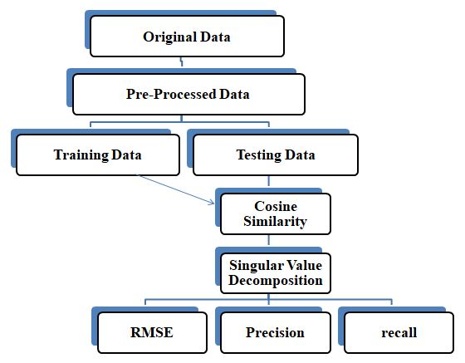
DESIGN

Slide 10

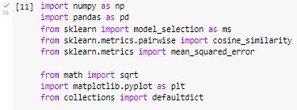
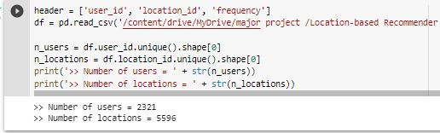
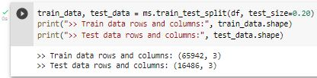
OUTPUT SCREENS

Slide 11
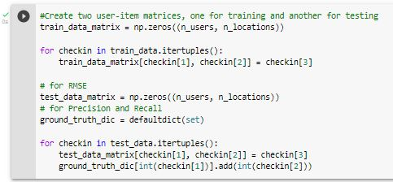
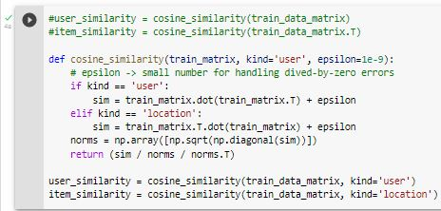
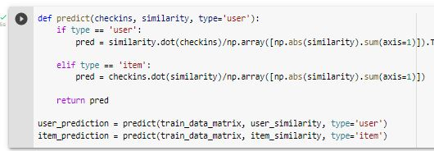
Memory Based Collaborative Filtering

Slide 12
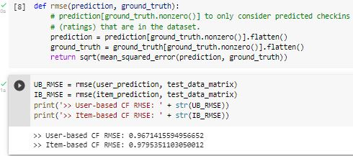

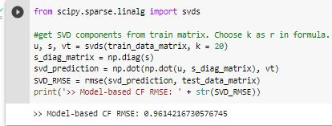
Evaluation
Model Based Collaborative Filtering
Singular Value Decomposition

Slide 13
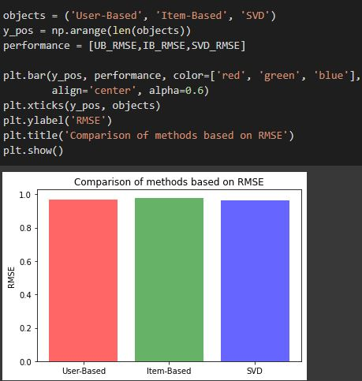
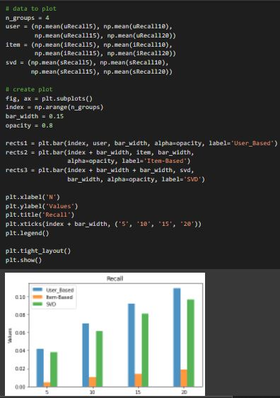
Fig: Comparison of methods based on RMSE
Fig: Evaluation using Recall

Slide 14
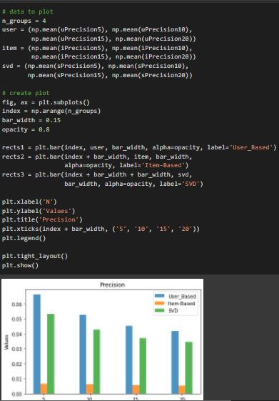
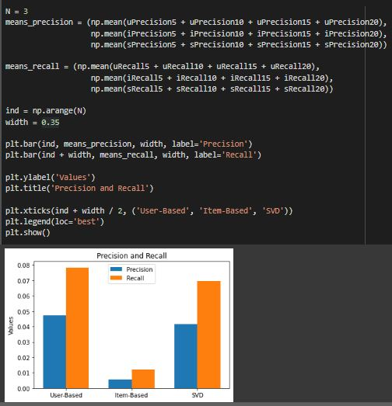
Fig: Evaluation using Precision
Fig: Evaluation using Precision and Recall

Slide 15
CONCLUSION AND FUTURE
In this project we have calculated the accurate Point-Of-Interests by using two approaches based upon the users interests.
In future this project can be even more extended and a feature of Sentiment Analysis can be added. Sentiment analysis is widely use technique for analyzing user preferences/interests.
Therefore, sentiment analysis technique is used to identify the sentences that contain different sentiment values and also the intensity of them.
Now, we would like to conclude that based upon the experimental analysis, we can say that the Memory-based CF algorithms are easy to implement and the result has appropriate prediction quality.
Experimental results show that our proposed method achieves significantly superior POI recommendations comparing with other recommendation approaches in terms of location promotion.

Slide 16
THANK YOU

